Slide 1
Git – GitHub and Tortoise Git From Developers Perspective

Slide 2
Traditional Approach of Maintaining Files
Version Control System (VCS) is a software that helps software developers to work together and maintain a complete history of their work.
Some of the feature of VCS as follows:
Allow developers to wok simultaneously
Does not allow overwriting on each other changes.
Maintain the history of every version.

Slide 3
Traditional Approach of Maintaining Files
Version Control System (VCS) is a software that helps software developers to work together and maintain a complete history of their work.
Some of the feature of VCS as follows:
Allow developers to wok simultaneously
Does not allow overwriting on each other changes.
Maintain the history of every version.

Slide 4

What is Git?
GIT means Global Information Tracker. It is free and open source tool
Git is a Version Control System for tracking changes in made within a file. The file can be a Text file, Excel File or it can also be a Java file.
We as a developers we use Git for tracking changes in source code during software development hence Git is also referred as SCM(Source Code Management)
Git is a version control system for tracking changes in computer files and created in 2005 by Linus Torvalds creator of Linux kernel.
Git Co-ordinates work between multiples of developers and tracks every single version, changes and history that made on the system files/projects.
Git can be revert back to any specific version of any file at any time as long as it is stored in repository.

Slide 5
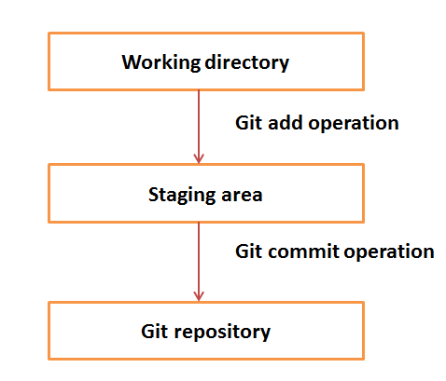
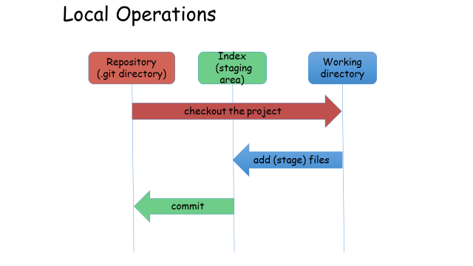
Git – Work flow
The workflow of Git.
Step 1 − You modify a file from the working directory.
Step 2 − You add these files to the staging area.
Step 3 − You perform commit operation that moves the files from the staging area. After push operation, it stores the changes permanently to the Git repository.

Slide 6

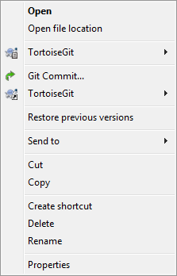

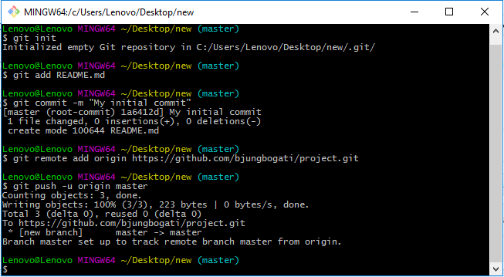
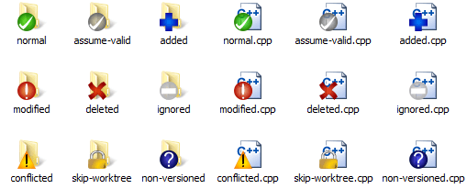
Tools Used in GIT
1)Git Bash with Command Prompt
2)Tortoise Git

Slide 7
GIT common Commands
Commands: −
$git init -> Create an empty Git repository
$git config –global user.name “name”->
$git config –global user.email “email”->
$git add “file name”-> add file to your staging area.
$git commit –m ”1st message”-> Commit a stage file.
$git status -> to see the state of your files(add, modified, remote).
$git log->to get history of your commits or commits made by someone else.
$git remote add origin”link”->Add the URL link from GitHub.
$git push origin master->pushes the file from local repo to Git hub(server).
$git pull origin master->pulls the files from Git hub to local area repo.
$git push –f -u origin master-> pushes the updated & force file from local repo to Git hub server.

Slide 8
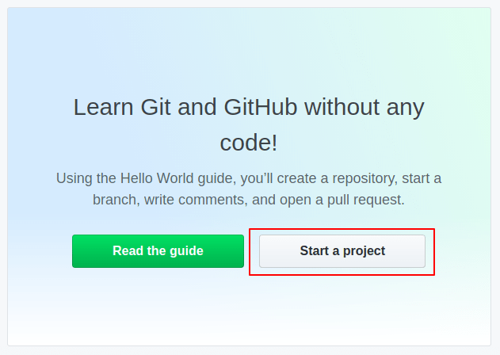
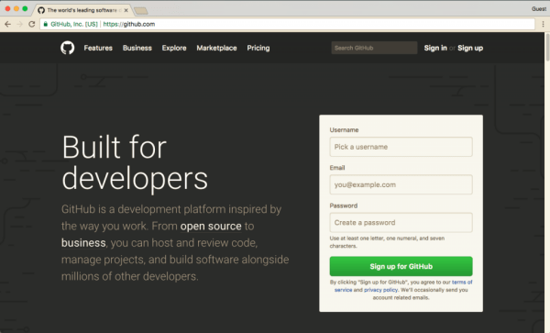
Create GitHub Repository
https://github.com/github

